Slide 1

Heart Disease Prediction Using Machine Learning
A Data Science Approach for Clinical Risk Screening
Presented by: Ibrahim Fahd Bindawod

Slide 2


Agenda
Project Objective
Dataset Overview
Data Preprocessing
Exploratory Data Analysis
Models Used
Evaluation Results
Model Interpretability
Real-World Impact
Limitations & Future Work
Conclusion & Recommendation

Slide 3

Project Objective
Objective: Build a machine learning model that predicts heart disease using patient health records to support early screening and clinical decisions.

Slide 4
Dataset Overview
Data Sources
Key Attribute | Source
70,000 patient records from multiple countries | cardio_data.csv
Key features: Age, blood pressure, cholesterol, activity, weight | cardio_data.csv
Binary target: 1 = disease, 0 = no disease | cardio_data.csv

Slide 5

Data Preprocessing
Removed extreme outliers (BP, weight)
Converted age from days → years
Encoded categorical features
Scaled numerical features
Removed null values

Slide 6
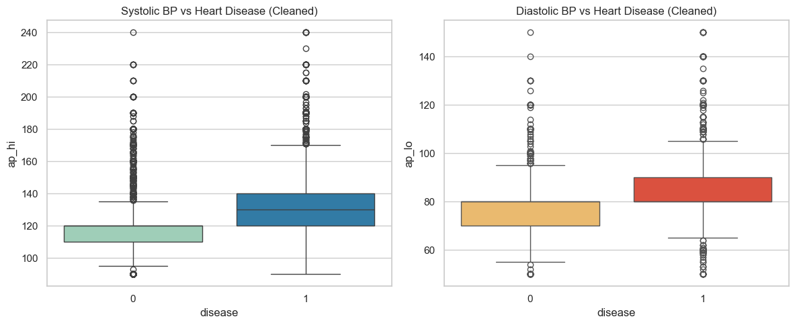
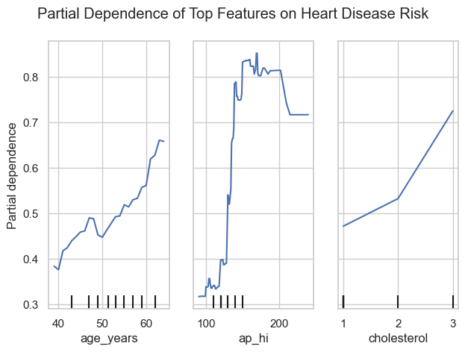
Exploratory Data Analysis
Boxplots showed blood pressure outliers
Correlation heatmap revealed age and BP linked to disease
PDP revealed increasing risk with age and weight
BP outliers removed; correlation confirmed clinical relevance of age and BP.

Slide 7
Models Used
Note | Type | Model
Baseline model | Linear | Logistic Regression
Good performance, easy to interpret | Ensemble | Random Forest
Best performer | Gradient Boosting | XGBoost
Slower, less interpretable | Margin-based | SVM

Slide 8
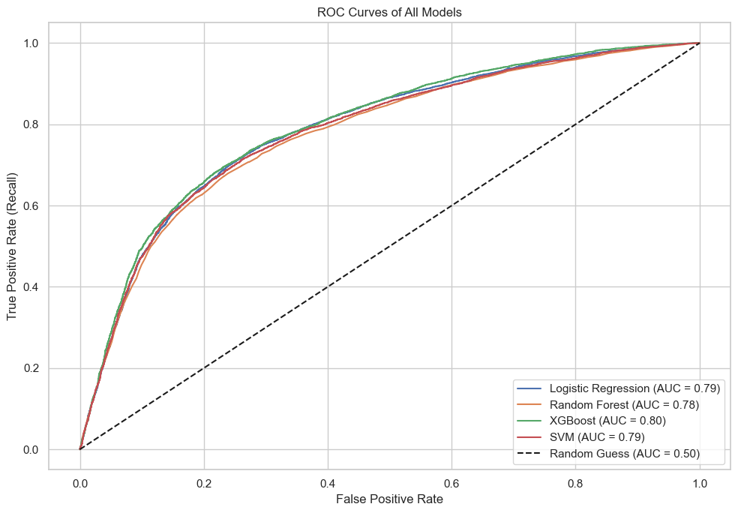
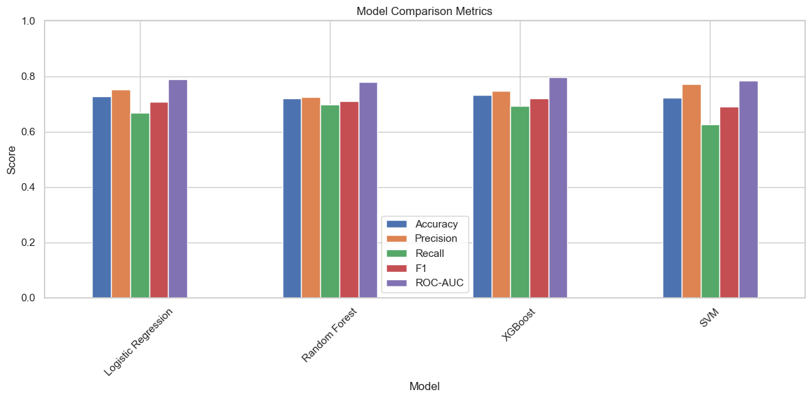
Evaluation Results
Models evaluated using Accuracy, F1 Score, Precision, Recall, and ROC-AUC
After tuning, XGBoost outperformed all others:
F1 Score: 0.723
ROC-AUC: 0.801
High recall and precision balance
Random Forest was a strong second; Logistic Regression improved but had lower recall

Slide 9
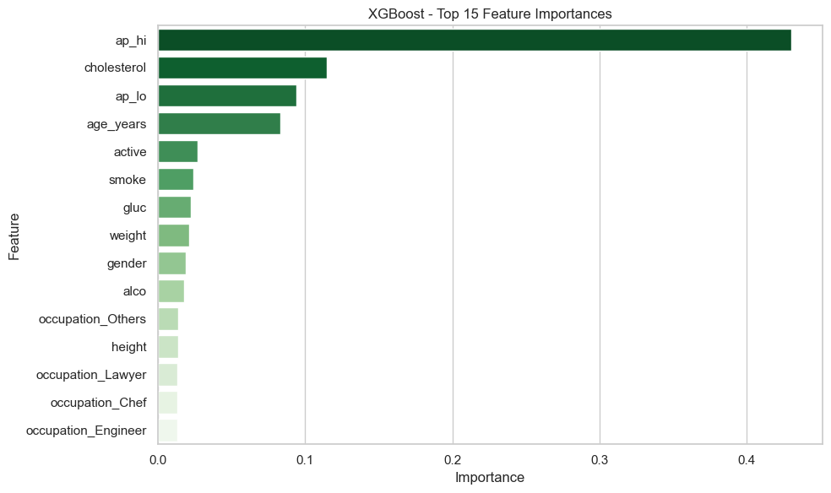
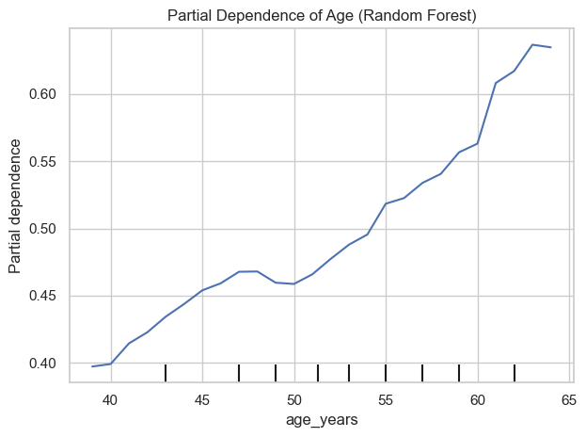
Model Interpretability
Feature importance (XGBoost & Random Forest):
Top predictors: age, ap_hi, cholesterol, weight
Partial Dependence Plots:
Showed that risk rises with age and systolic BP
Confirmed model learned clinically relevant patterns
Permutation importance supported feature relevance

Slide 10

Real-World Impact
Use Cases:
Assist clinicians during screenings
Flag high-risk patients
Integrate with EHR dashboards
Benefits:
Automates initial risk flagging
Scales across population-level data
Supports early lifestyle or treatment interventions

Slide 11

Limitations & Future Work
Limitations:
No ECG or lab-based clinical variables included
Dataset limited to 4 countries
Cross-sectional only (no time series)
Binary labels without detail
Future Work:
Add lab/ECG data
Validate model on new hospital data
Deploy in pilot programs with clinical partner feedback
Engage physicians for usability feedback

Slide 12

Conclusion & Recommendation
Recommendation:
Use XGBoost as a clinical decision support tool. It offers high recall, strong ROC-AUC, and interpretable patterns aligned with medical knowledge.
XGBoost | Metric
0.723 | F1
0.801 | AUC
Ap_hi, cholesterol, age | Top Features

Slide 13
Thank you for your time and attention

